Slide 1
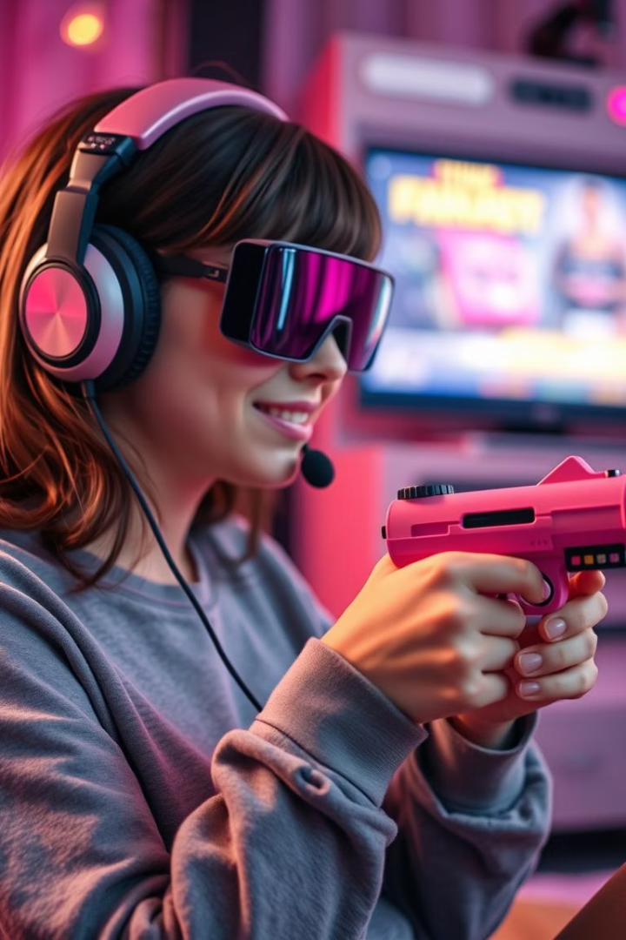
Project: Andhadhun - A Game for the Blind
Experience Andhadhun, an immersive audio-based adventure designed for the visually impaired. Navigate with a revolutionary handgun controller and spatial audio.
Team A.T.O.M

Slide 2
The Vision: Gaming Beyond Sight
Accessible Gaming
Engaging Experience
Addressing the gap in accessible gaming for the blind community, impacting over 285 million people globally.
Providing an action-oriented experience that challenges perceptions of what's possible in gaming.

Slide 3




Handgun Controller: Your Guide in the Dark
IMU Tracking
Precise head tracking with an Inertial Measurement Unit (IMU).
Haptic Feedback
Vibrational feedback for object proximity and environmental cues.
Intuitive Controls
Aiming, shooting, and navigating through virtual space.

Slide 4




Spatial Audio: Painting a Sonic Landscape
3D Soundscape
Directional Cues
Binaural audio technology creates an immersive 3D soundscape.
Pinpointing enemy locations and navigating environments.
Dynamic Effects
Realistic ambient sounds and object interactions.

Slide 5
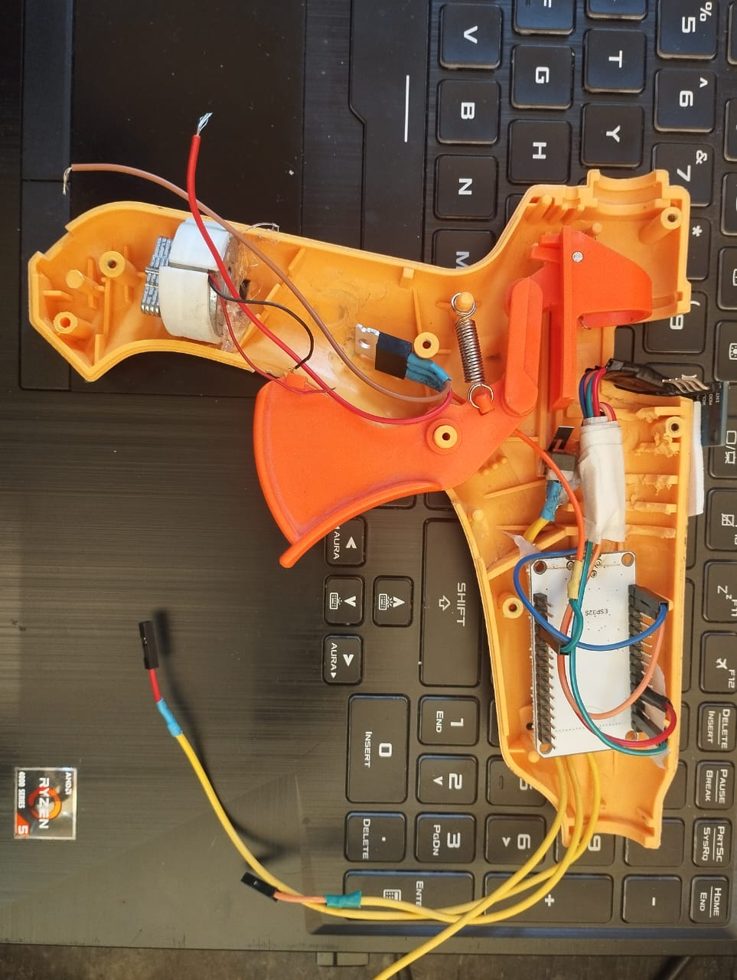



Gameplay Mechanics: Thrills in the Dark
Thrilling Action
Navigate dangerous environments and evade enemies.
Ramp up scores
Beat your personal best and compete with friends
Compelling Narrative
Immerse yourself in a rich storyline with intriguing characters.

Slide 6
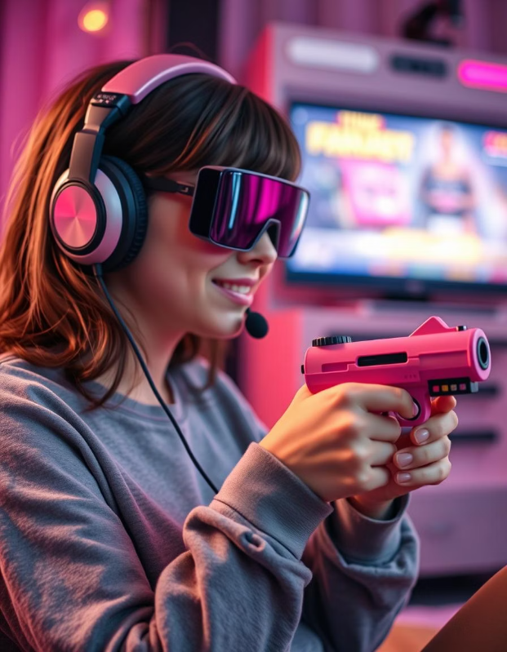



Accessibility Features: Designed for Inclusivity
Customizable Audio
Fine-tune soundscape for individual needs and preferences.
Adjustable Haptics
Personalize the sensory experience with adjustable feedback intensity.
Inclusive Design
Gameplay designed for users of all abilities.

Slide 7
Impact and Potential: Beyond Entertainment
Empowerment
1
Accessible gaming for the blind community.
Inclusivity
2
Challenging societal perceptions.
Applications
3
Rehabilitation and assistive technology.

Slide 8

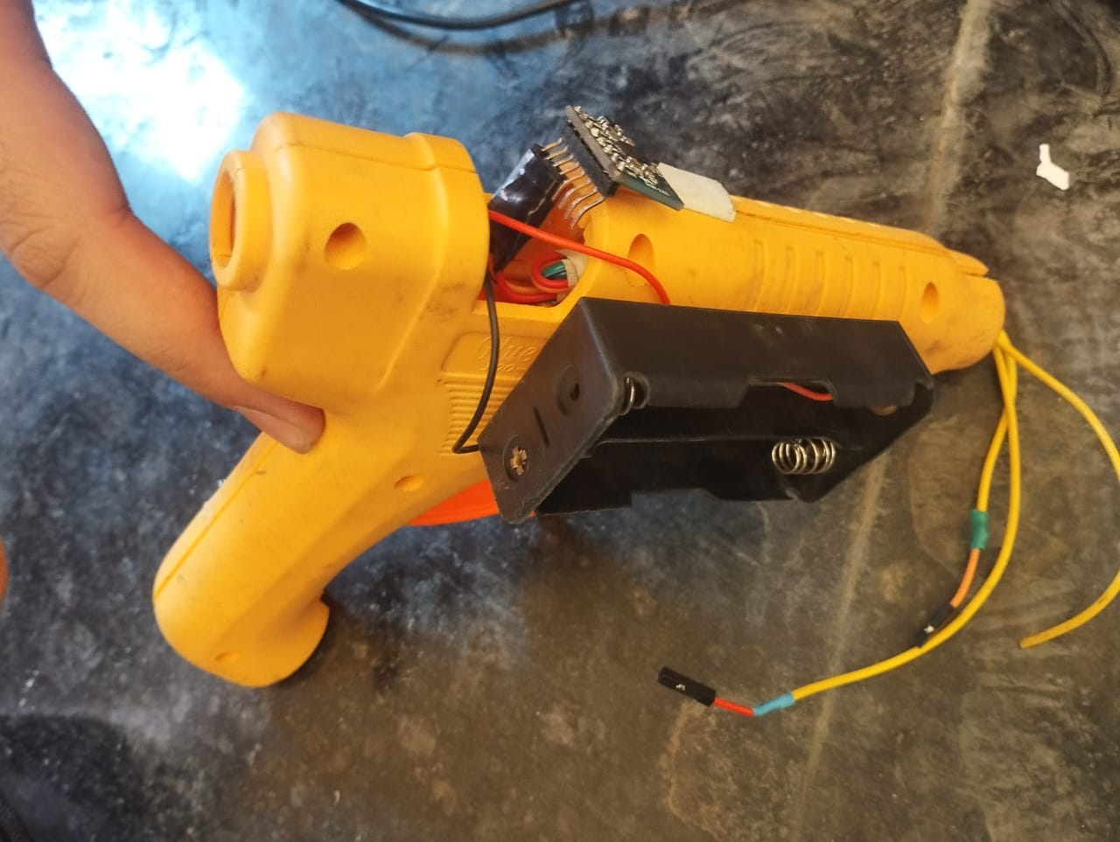
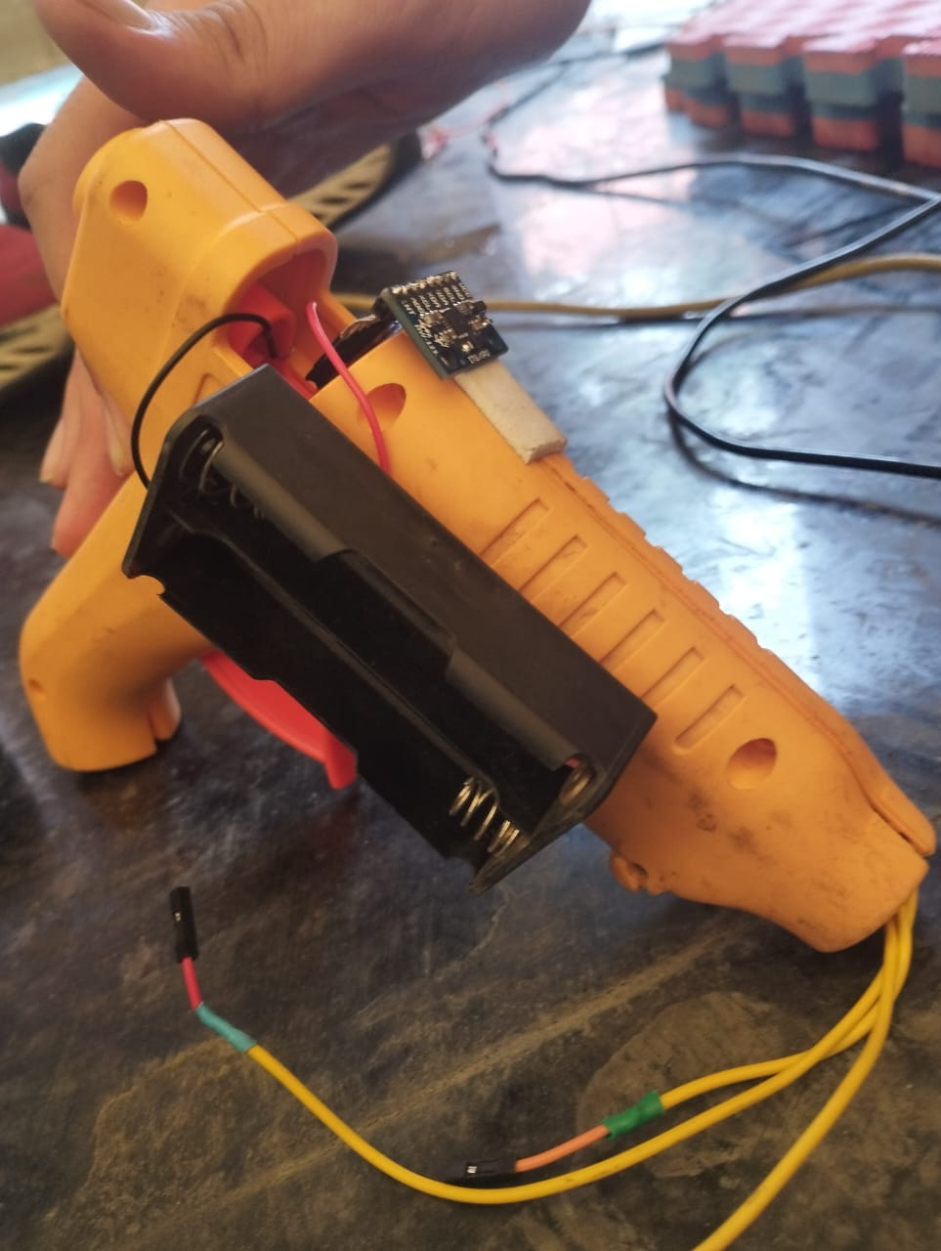
Join the Andhadhun Revolution!

